Slide 1
Varroa Mite Treatments
Huguenot Beekeepers Association
August 2016

Slide 2
WARNING!!
This is only an overview.
Research each treatment method thoroughly before making a plan of action.
Every beekeeper will have an opinion – please be respectful of each other.

Slide 3
Methods to control Mites
Mechanical & Physical
Genetics
Natural treatments
Chemical treatments

Slide 4
Mechanical & Physical
Screened bottom boards
Drone trapping
Powdered sugar dusting
Time consuming
Questionable efficacy

Slide 5
Genetics
Pest resistant bees
Russian bees
VSH – Varroa Sensitive Hygiene
Minnesota Hygienic bees
New World Carniolan
Purdue “Ankle Biters”

Slide 6
Natural Treatments
Might Away Quick Strips – Formic acid
Api Life Var – Thymol
Apiguard – Thymol
Oxalic Acid
Hopguard II – Hops derivitive

Slide 7
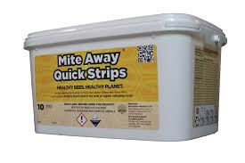
Mite Away Quick Strips
Main ingredient: Formic Acid
Considered organic and found in the insect world, especially ants
7 day treatment
Comes in 2 pack (4 strips) to treat 2 hives or a 10 pack
May be used in ½ dose or 1 strip application
Only treatment that kills mites in capped brood
Safe to use with honey supers on
Temperature range – 60-92 degrees

Slide 8
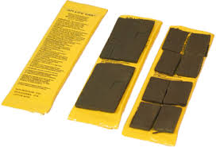
Api Life Var
Main Ingredient: Thymol
Install squares on day 1, day 7 & day 14 for a total of 21 days in brood area – 3 week treatment
Low residue
Comes in 2 packs which is 1 of 3 treatments for 2 hives
No honey supers allowed when using
Temperature requirement– 64 to 95 degrees

Slide 9
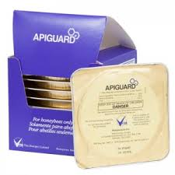
Apiguard
Main ingredient: Thymol
1 tray or pad per hive for 14 days, remove then repeat
Total of 4 weeks of treatment
Comes in 10 pack (Individually wrapped) & 50 pack
No honey supers allowed when using
Maximum temperature - 105 degrees

Slide 10
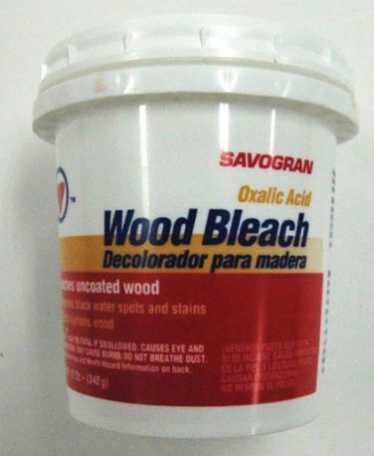
Oxalic Acid
Main ingredient: Oxalic acid (wood bleach)
Used with a vaporizer hooked to a battery
Only kills mites it comes in contact with
Several treatments necessary – Every 7 days for 3 weeks
Works best when little or no brood is in hive
No temperature restrictions

Slide 11
HopGuard II
Main ingredient: Hops derivitive
2 insert strips per 10 frames
Leave in the hive for minimum of 14 days
Can be used throughout the year
Sold in packs of 24 strips (12 treatments)
No temperature restrictions

Slide 12
Chemical Treatments
Apivar – Amitraz
Apistan – Tau-fluvalinate
CheckMite+ - Coumaphos

Slide 13
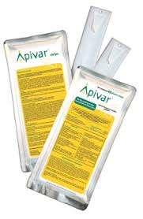
Apivar
Main ingredient: Amitraz
3 to 4 strips used per hive
Comes in 10 & 50 packs
Leave on hive 42 but no longer than 56 days
No honey supers allowed when using
Doesn’t store well once opened
No temperature restrictions

Slide 14
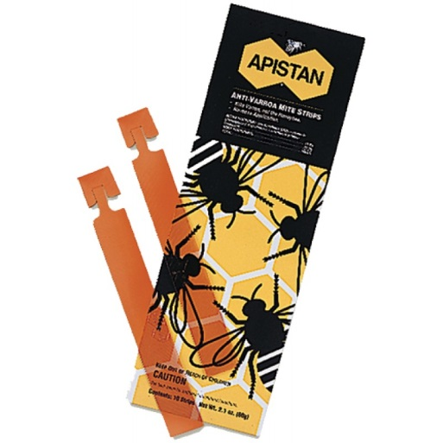
Apistan
Active ingredient: Tau-fluvalinate
3 to 4 strips hung in hive for 6 weeks and no more than 8 weeks
Comes in 10 pack and 100 strip pack
Does not contaminate honey
No temperature restrictions

Slide 15
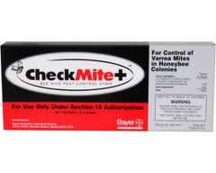
CheckMite+
Main ingredient: Coumaphos
Hang 1 strip for each 5 combs of bees in brood chamber
Leave in hive for 42 days but not more than 45 days
Cannot install honey supers for minimum 2 weeks after use
Also kills Small Hive Beetles
No temperature restrictions

Slide 16
CAUTION!!
Always use appropriate gloves when handling chemical treatments.
In some cases, respirators must also be used.
Never open containers indoors.
ALWAYS follow product application instructions.

